Slide 1
Ovarian Cancer Biomarkers
By: Andrea Hannah for MSDS570

Slide 2
Presentation
Introduction
Goals
Dataset and Characteristics
Exploratory Analysis of Data
Visualization Techniques Used
Conclusion
Contents

Slide 3
Introduction
Notes:
Introduct

Slide 4
Problem: Ovarian Cancer
Ovarian Cancer is a group of diseases that originate in the ovaries or in the fallopian tubes or peritoneum.
Ovaries produce the female hormone and reproductive eggs.
Ovarian cancer is best treated at its earliest stages before becoming aggressive, as it is the fifth deadliest cancer to women.
Therefore, early screening and diagnosis is key to successfully treating the disease, curing, or entering remission.
Ovarian Cancer is screened through two methods:
TVUS (transvaginal ultrasound, a test using sound waves to look at the uterus, fallopian tubes, and ovaries. It can find a mass, but it can't tell if a mass is cancer or benign. When it is used for screening, most of the masses found are not cancer.
The CA-125 blood test measures the amount of a protein called CA-125 in the blood.
Many women with ovarian cancer have high levels of CA-125. This test can be useful as a tumor marker to help guide treatment in women known to have ovarian cancer, because a high level often goes down if treatment is working.
Note, checking CA-125 levels has not been found to be as useful as a screening test for ovarian cancer because high levels of CA-125 is more often caused by common conditions such as endometriosis and pelvic inflammatory disease, and, not everyone who has ovarian cancer has a high CA-125 level.
Therefore, other biomarkers should be used in conjunction with CA-125 to screen for ovarian cancer.
Notes:
A

Slide 5
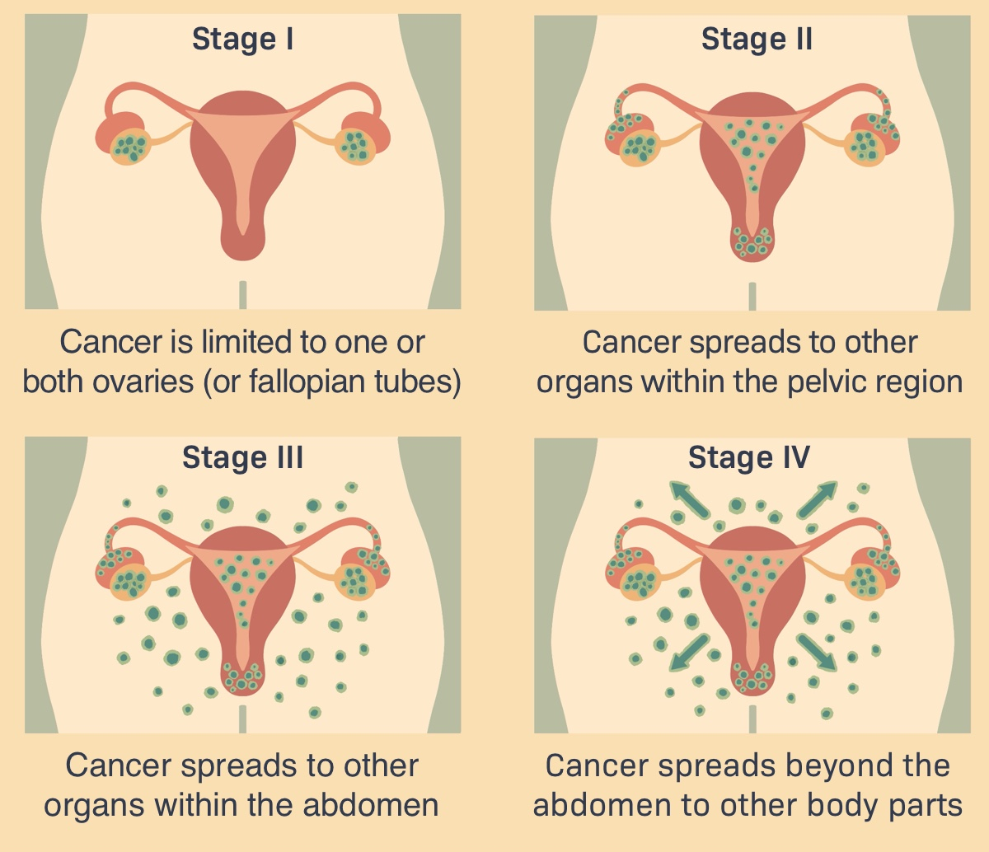
Stages of Ovarian cancer
Source: https://advancedovariancancer.net/diagnosis/stages
Notes:
A

Slide 6
Project Goals
Goal: The goal of this project is to produce visualizations that successfully illustrate the relationships between the variables, identifying contributing variables that can be assessed alongside CA-125 to improve ovarian cancer screening.
Plan: I divided the variables and performed heat maps to find variables that correlate with CA-125. Data visualization techniques were deployed to visually examine the trends of these potential ovarian cancer screening biomarkers together.
Notes:
A

Slide 7
The Data
Notes:
Introduct

Slide 8
Dataset
The original Ovarian Cancer Dataset has 349 observations and 51 variables, the cleaned data set is comprised of 236 observations and 47 variables including Age, Menopause (Y/N), HE4 and CA125, among other biomarkers found in blood or serum samples. This dataset includes the following initial biomarker features of interest:
Age, CA-125, HE4, Ca, Menopause, MCH, MCV
Visualizations: To identify the biomarkers that may help with early detection through use of heatmaps and scatterplots.
Cleaned Dataset was sourced from Kaggle.
Notes:
A

Slide 9
Exploratory Data Analysis
Notes:
Introduct

Slide 10
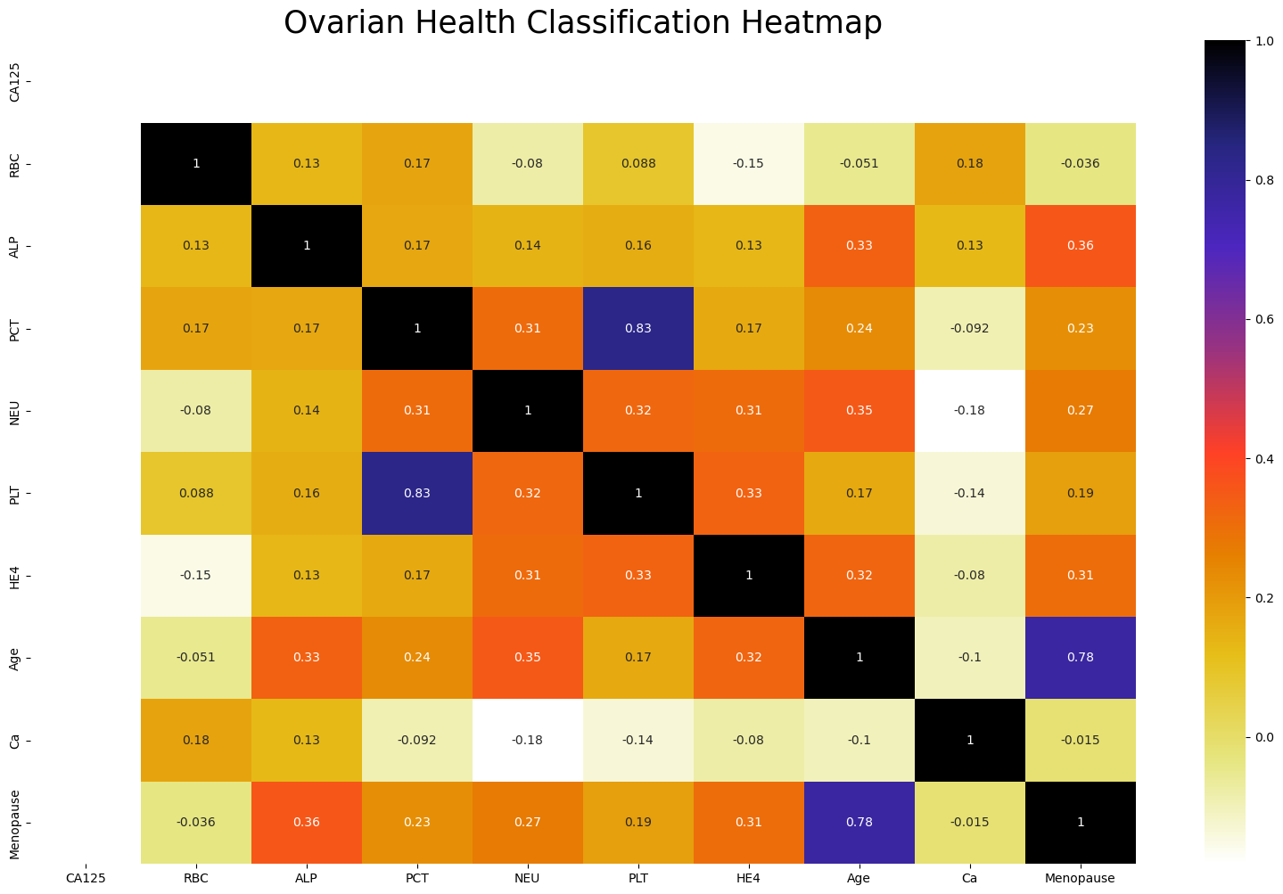
With any research using this dataset, we would drop the highly correlated features shown in this heatmap from the model. PCT and PLT were dropped.
Heatmap Correlation
Notes:
A

Slide 11
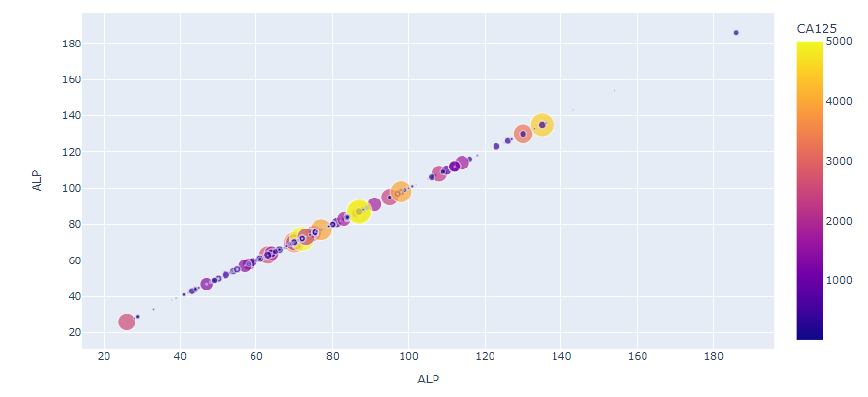
Examining relationship between Alkaline Phosphatase and CA125 levels
Notes:
T

Slide 12
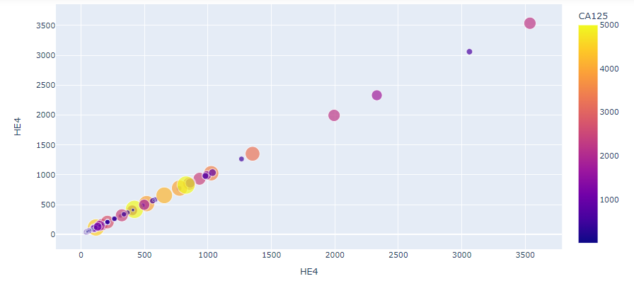
Examining relationship between HE4 and CA125 levels
Notes:
T

Slide 13
Brief Description of Visualization Techniques and Results
Notes:
Introduct

Slide 14
Visualization Selection:
Heat Maps and Scatter Plots
The Heatmap visualization shows which variables are correlated with one another.
The Scatterplot visualization is used to show the relationship between variables.
Using these methods, the visualization results yielded:
Higher Calcium levels are associated with higher CA125 levels of risk not lower as expected.
Higher ALP levels are associated with higher CA125 levels of risk.
Higher HE4 levels are not supported as related with higher CA125 levels of risk with this dataset.
As expected, menopause and age correlate with higher CA125 levels
Notes:
A

Slide 15
Future Work
Notes:
Introduct

Slide 16
Missing Information
Racial identification
Number of pregnancies
Number of c-sections
Weight (BMI, obesity)
Inherited factors
Nutrition (calcium intake, vitamin D)
Lifestyle (sun exposure, exercise)
Stress factors
These missing features and others could improve research and help with eliminating disparities in clinical practice for those with known environmental factors that contribute to poor health outcomes.
Notes:
T

Slide 17
Conclusion
Notes:
Introduct

Slide 18
Conclusions
Increasing the number of observances, i.e. patients, in our dataset will help teams needing identify the most important biomarkers.
Increasing dataset would help eliminate disparities in screening/diagnosis, treatment, and survival rates for ovarian cancer patients of particular targeted populations.
A future study would be to supplement additional work to be done on screening biomarkers for patients based on racial and environmental characteristics but to eventually analyze and predict comorbidities in order to predict the composition of the wholistic care team of specialists (heart-renal-metabolic, etc.) needed that may be required for particular cancer patients to improve survival rates by starting with a larger dataset requested from the National Cancer Institute or create one in-house.
An in-house study at an institution like Meharry makes sense, given that 5-year relative survival rate for ovarian cancer increased from 33% to 48% among non-Hispanic White women but decreased from 44% to 41% in African American women.
The study would be a joint collaboration between Meharry institutes: the Center for Advanced Scientific Computing, Innovation and Center of Women’s Health, and eventually the Center of Health Policy since there are disparities in ovarian screening and treatment costs under Medicaid. Alternatively, a study could be established at another institution sharing a mandate for improved equity in black health.
Notes:
A

Slide 19
References
[1] February 23, 2023, January 20, 2023, & March 9, 2023. (n.d.). Ovarian cancer studies aim to reduce racial disparities. National Cancer Institute. Retrieved March 31, 2023, from https://www.cancer.gov/news-events/cancer-currents-blog/2020/ovarian-cancer-racial-disparities-studies
[2] Ovarian - datasets - PLCO - the cancer data access system. National Cancer Institute - Cancer Data Access System. (n.d.). Retrieved March 31, 2023, from https://cdas.cancer.gov/datasets/plco/23/
[3] Shahane, S. (2021, February 6). Predict ovarian cancer. Kaggle. Retrieved March 31, 2023, from https://www.kaggle.com/datasets/saurabhshahane/predict-ovarian-cancer
[4] American Cancer Society. (n.d.). Can Ovarian Cancer Be Found Early? Early, Detection, Diagnosis, and Staging. Retrieved from https://www.cancer.org/cancer/ovarian-cancer/detection-diagnosis-staging/detection.html

